Slide 1
system for communication at restaurants
SCAR
Notes:
The idea for the project is a System for communication at restaurants, in short, SCAR
The purpose of the system is to allow and facilitate a discrete and immediate communication between customers and staff.

Slide 2


Problems description
Notes:
As any other product, it’s developed because there are problems that I want to tackle. Problems such as noisy customers calling the staff by shouting or gesturing in order to try and attract the attention of the waiters. Or if you are a well mannered, polite customer who has MAYBE waited a bit too long for the waiters to acknowledge you. Or you have a spilled drink and need assistance from the staff. You can contact them, in that moment, without having to search for them.

Slide 3
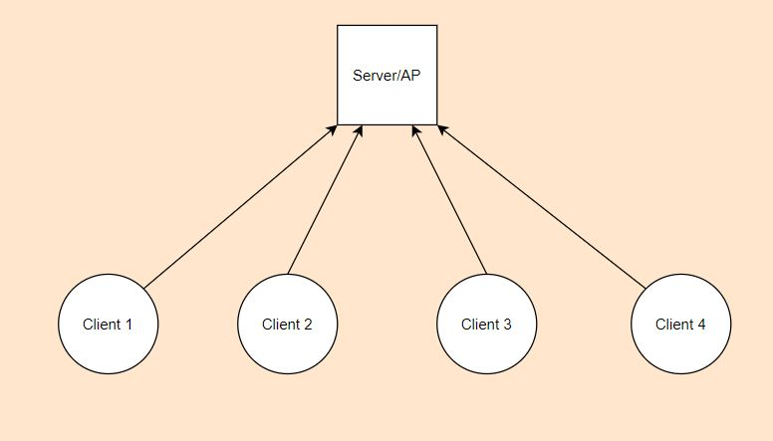
Diagrams
Notes:
Before I tell you HOW it works exactly. I believe that itll be easier for you to actually SEE how its setup by showing you the diagrams. This is an example of multiple clients connected to the AP via WiFi. In a restaurant or a café this is what we usually see

Slide 4

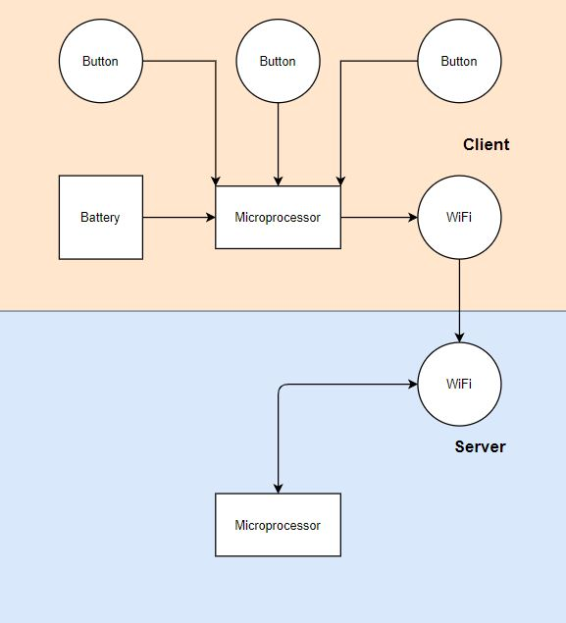
Block diagram
Notes:
This is actually the block diagram which can be found in the documentation. It depicts how the client and server are connected within the configuration of their devices. Here you can observe that the client device has a microprocessor powered by a battery. It has 3 buttons attached to it, they are used to determine the commands which will be sent to the server. The commands being CALL in case you want to order or you need assistance, BILL if you want them to bring the check, and CANCEL, if you want to cancel your last command. Those commands will be sent via the WiFi module and received by the server where they’ll be processed and itll notify the staff whether LED or buzzers or as well see in a little bit, a web interface.

Slide 5
Lolin NodeMCU V3
ESP8266
WiFi module
Arduino IDE
Availability
Notes:
The Lolin NodeMCU V3 is the device chosen for the proof of concept. It’s a small board with a ESP8266 processor and a WiFi module,.Furthermore it is the lowest cost WiFi board on the market, which makes it nearly perfect for the purposes of this project.

Slide 6
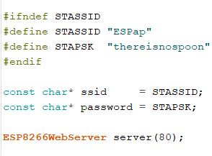
Server Side
Notes:
There will be web-server running on the ESP8266, in order to accept the requests of the clients and notify the staff. The reason why the server side is on the same device as the client is because it’s small enough to be integrated with a smartphone/ smartwatch in order to divide the restaurant in sections. So that commands from one section reach only the waiter dedicated to that section. Another possibility is that those smartphone and watches can be another client that can access the inquired commands through a web interface. This is a simple declaration of the SSID and password, which are PREDETERMINED. The last line creates a webserver object that listens for HTTP request on port 80

Slide 7

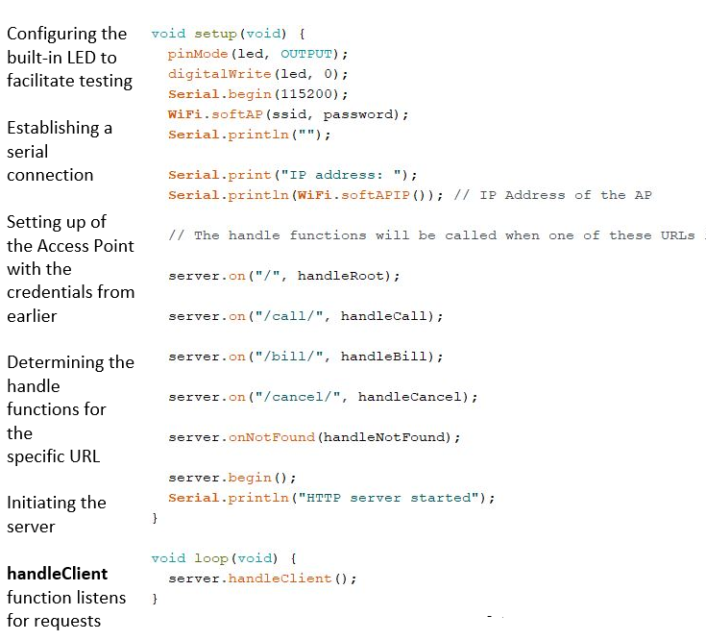
Server Side
Notes:
WiFi.softap important – configuring and starting AP
Determining what function will be executed when an http request is sent to this url

Slide 8
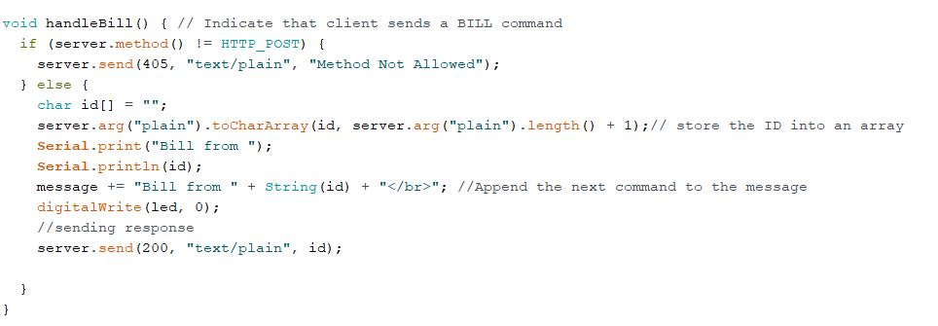
handlers
Notes:
Simple check for HTTP_POST method. Char Array to hold the ID. server.arg(“plain”) is used to access the body of the http request
Printed on the serial monitor + appended to a global variable “message” that will be shown on the web interface

Slide 9
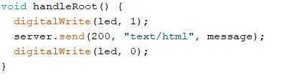
Handleroot
Notes:
HandleRoot function will be executed when an http request is sent to the root

Slide 10
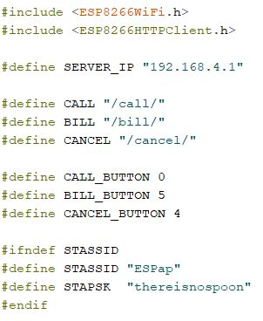
Client Side
Notes:
Defining macros

Slide 11
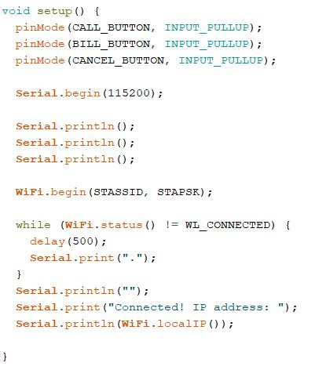
Client Side
Notes:
First, Buttons are set as Internal pull up inputs
WiFi.begin is important – as it connects with the AP
Check if connected, print if connected

Slide 12
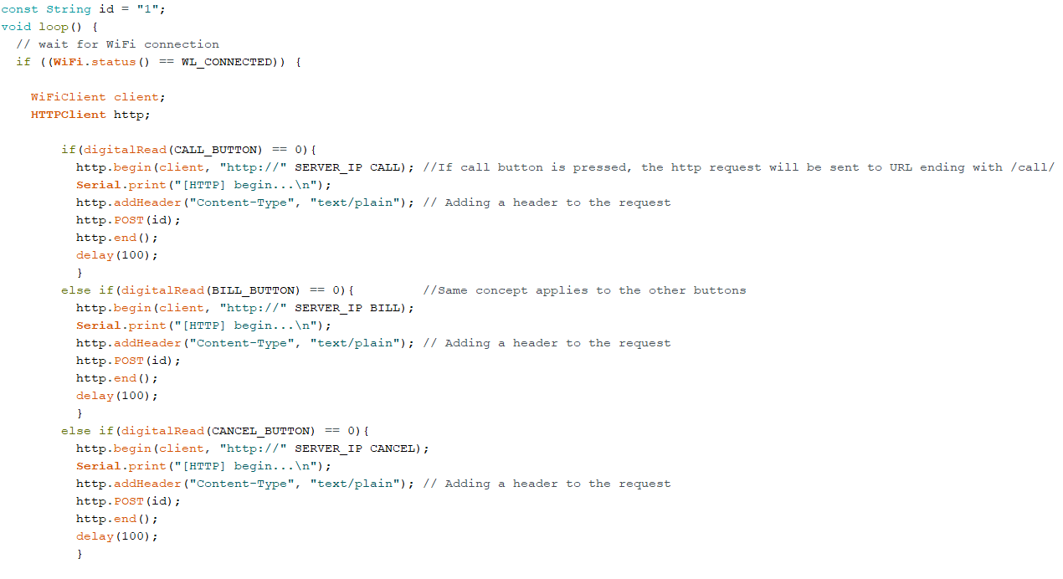
Client Side
Notes:
Important ID DECLARATION – UNIQUE so that waiters know where to go.. http object is used to send the http_requests.. http.begin function establishes a TCP connection with the URL that changes depending on the button that is pressed

Slide 13
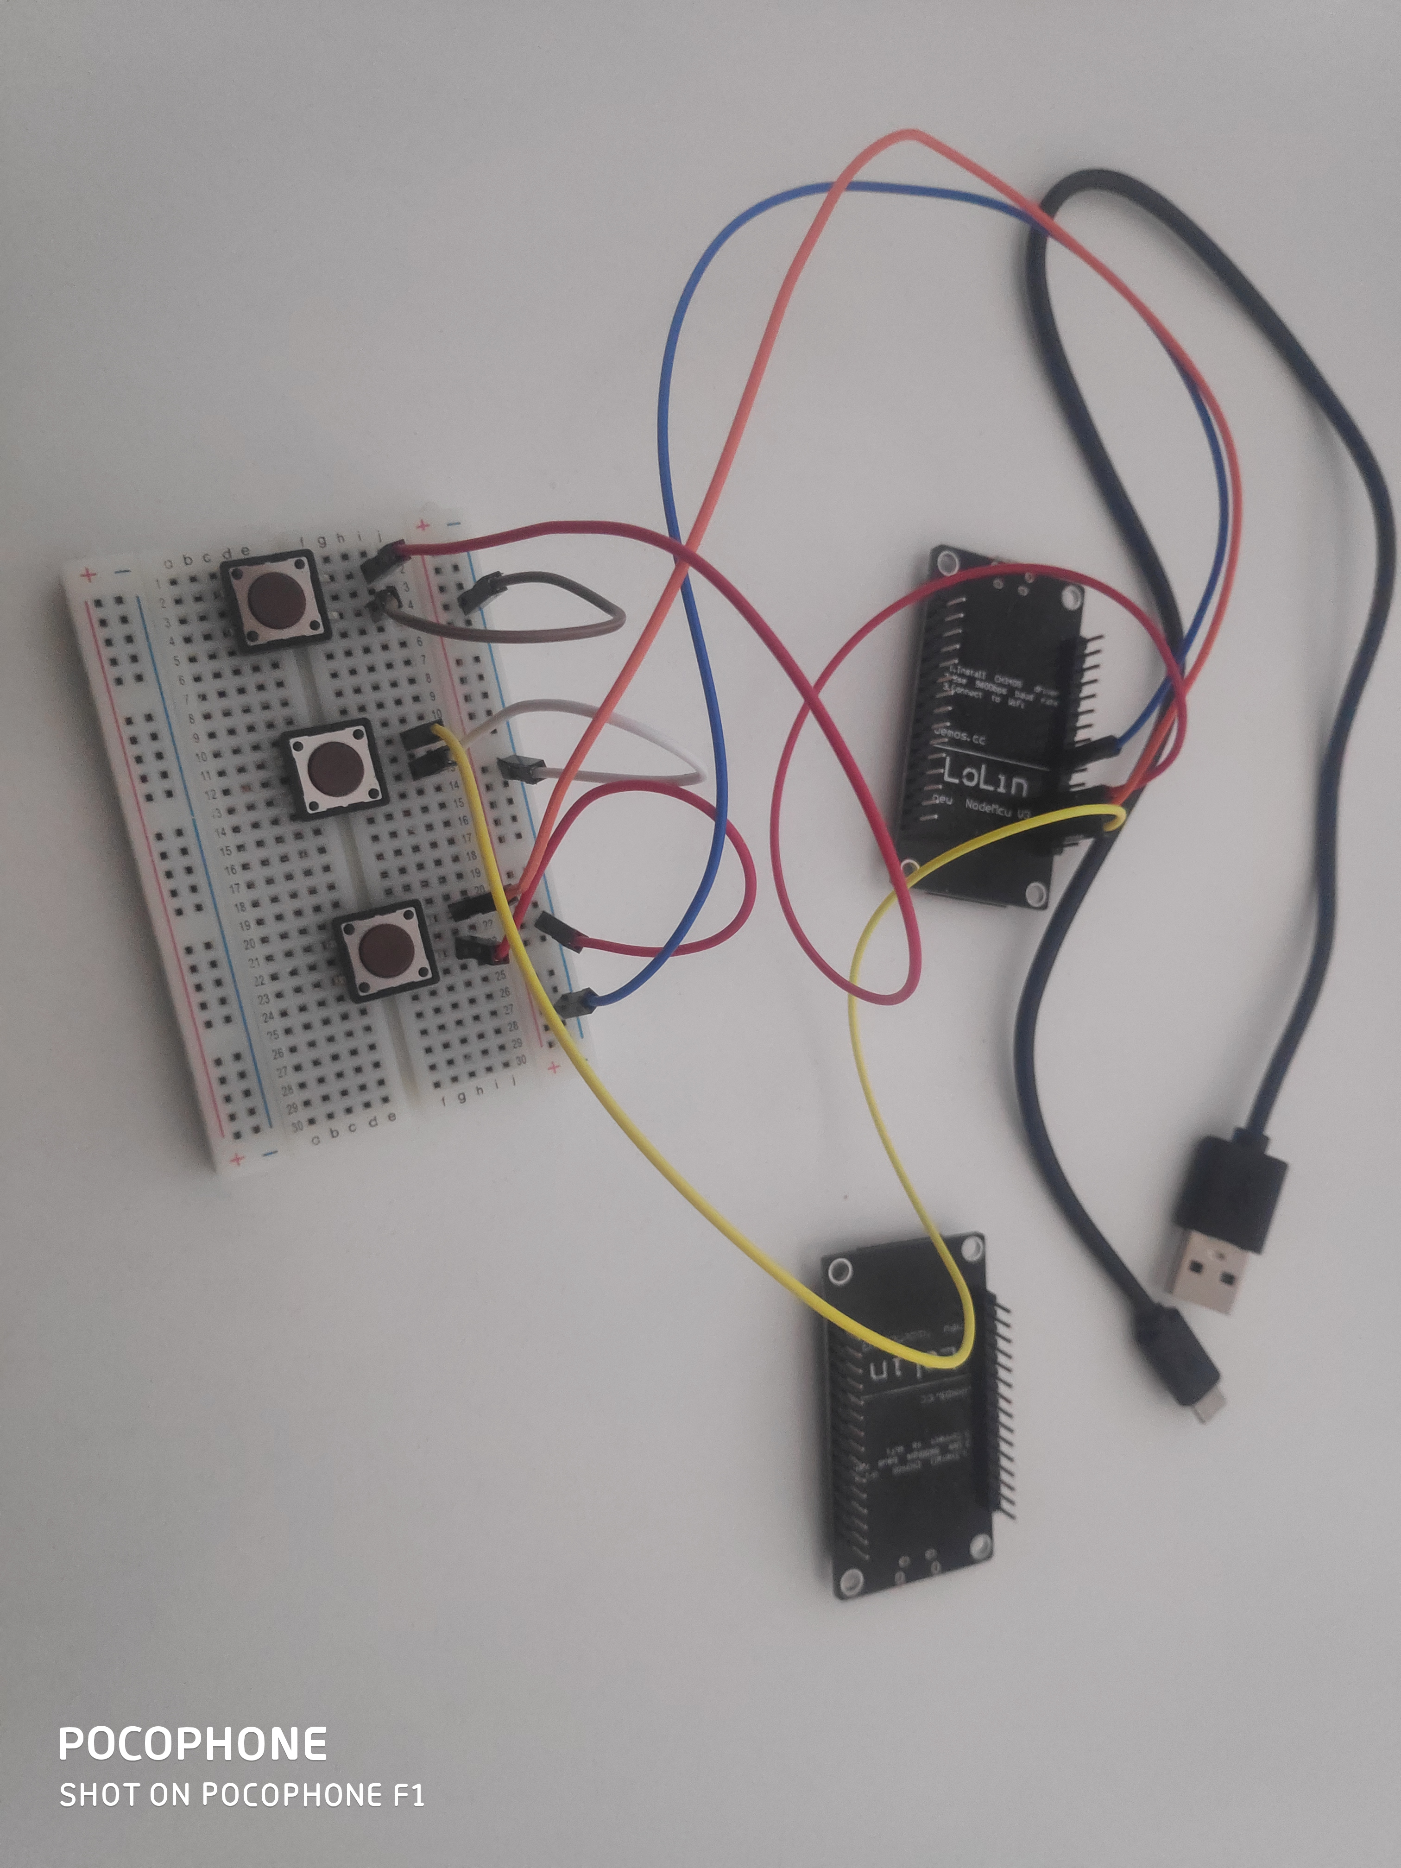
testing
Notes:
This is the setup used for the final test

Slide 14
Thank you for your attention

